Slide 1
CHAPTER 5
Multivariate Probability Distributions

Slide 2
OBJECTIVES
Joint Discrete Distributions
Joint Continuous Distributions
Marginal Discrete Distributions
Marginal Continuous Distributions

Slide 3
Two Discrete Random Variables

Slide 4
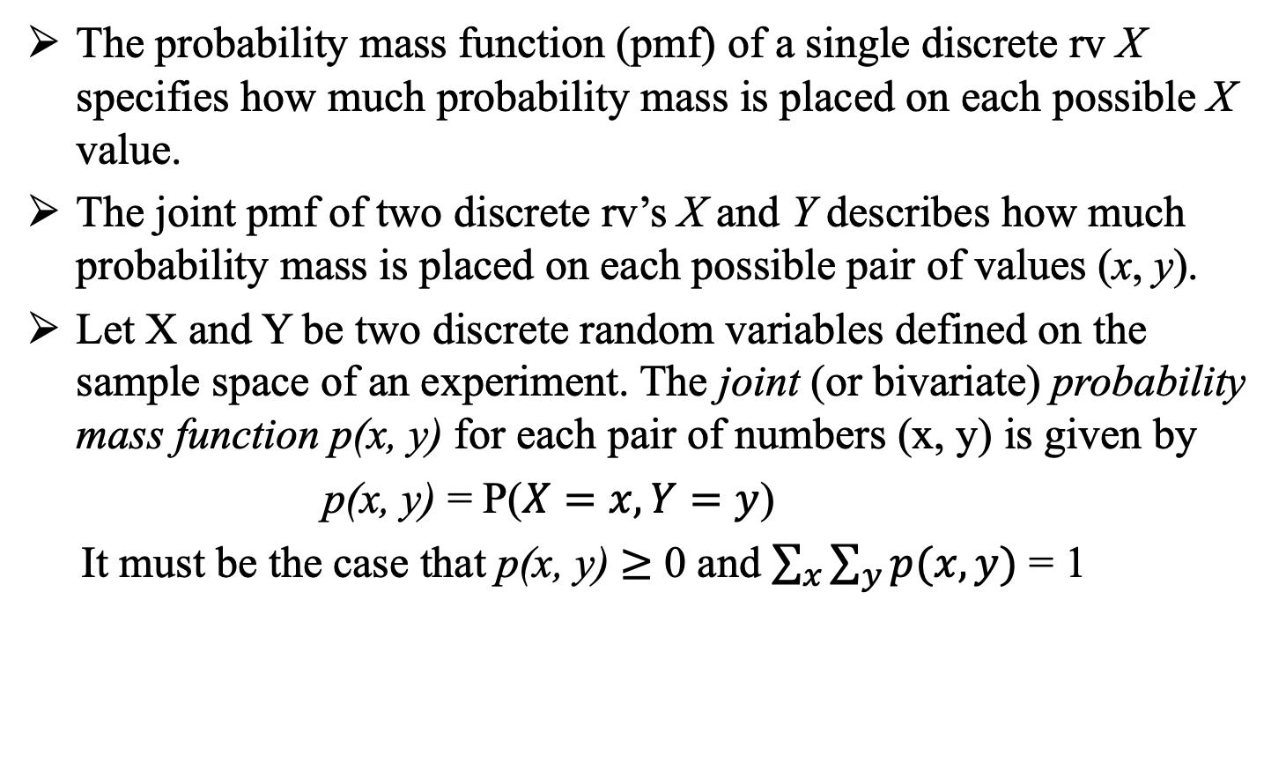
Two Discrete Random Variables
The probability mass function (pmf) of a single discrete rv X specifies how much probability mass is placed on each possible X value.
The joint pmf of two discrete rv’s X and Y describes how much probability mass is placed on each possible pair of values (x, y).
Let X and Y be two discrete random variables defined on the sample space of an experiment. The joint (or bivariate) probability mass function p(x, y) for each pair of numbers (x, y) is given by
p(x, y) = P($X=x, Y=y$)
It must be the case that p(x, y) $≥$ 0 and $\sum_{x}{\sum_{y}{p(x, y)}}$ = 1

Slide 5
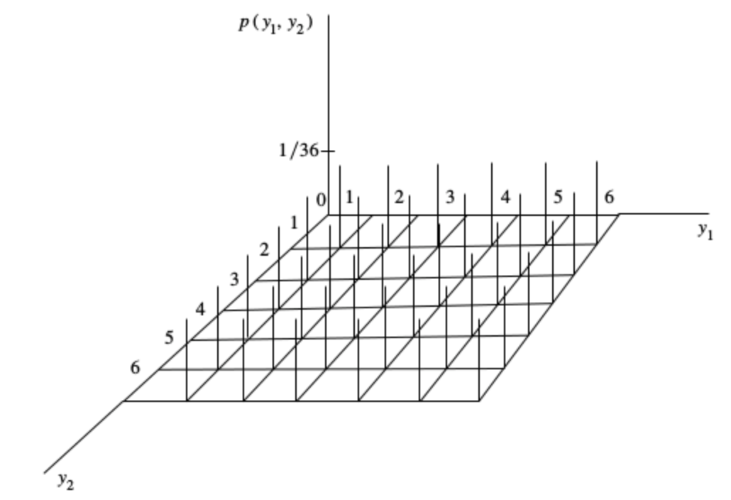
Example 1
Bivariate Probability Function: y1 = number of dot on die 1,
y2 = number of dot on die 2
There are exactly 36 points in the
plane that are assigned nonzero
probabilities.
The points assigned nonzero
probabilities are represented in the
plane, whereas the probabilities
associated with these points are
given by the lengths of the lines
above them.
Figure may be viewed as a
theoretical, three-dimensional
relative frequency histogram for
the pairs of observations .

Slide 6
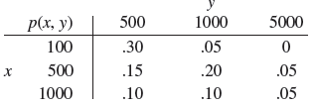
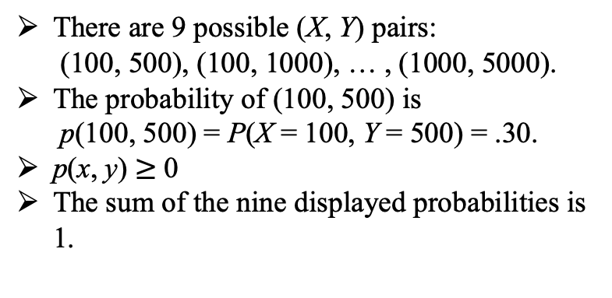
Example 2
Anyone who purchases an insurance policy for a home or automobile must specify a deductible amount, the amount of loss to be absorbed by the policyholder before the insurance company begins paying out.
Suppose that a particular company offers auto deductible amounts of $100, $500, and $1000, and homeowner deductible amounts of $500, $1000, and $2000. Consider randomly selecting someone who has both auto and homeowner insurance with this company, and
let X =the amount of the auto policy deductible and
Y = the amount of the homeowner policy deductible.
There are 9 possible (X, Y) pairs:
(100, 500), (100, 1000), … , (1000, 5000).
The probability of (100, 500) is
p(100, 500) = P(X = 100, Y = 500) = .30.
p(x, y) $≥$ 0
The sum of the nine displayed probabilities is
1.
Joint probability table for the joint pmf of X and Y

Slide 7
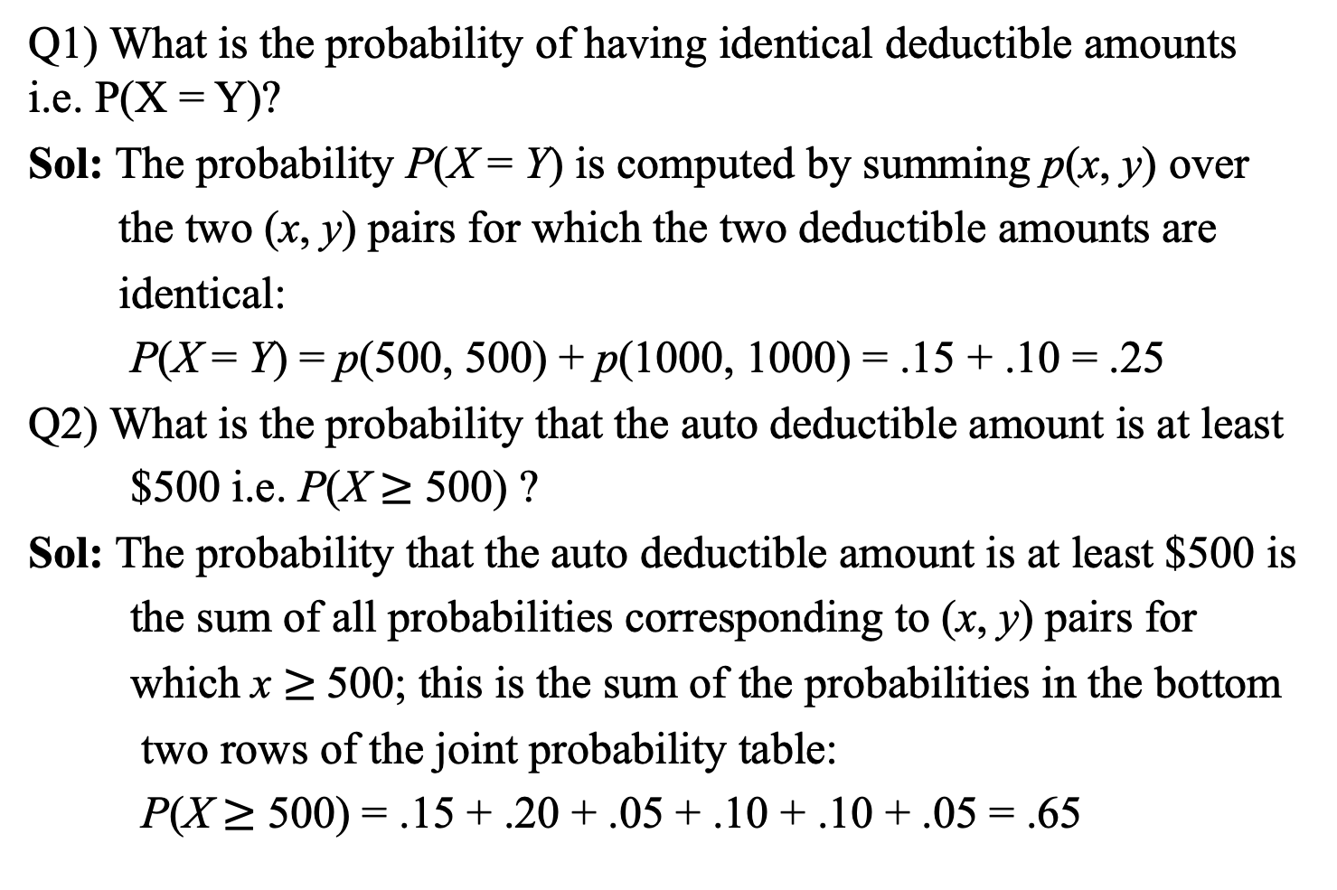
Example 2
cont’d
Q1) What is the probability of having identical deductible amounts i.e. P(X = Y)?
Sol: The probability P(X = Y) is computed by summing p(x, y) over
the two (x, y) pairs for which the two deductible amounts are
identical:
P(X = Y) = p(500, 500) + p(1000, 1000) = .15 + .10 = .25
Q2) What is the probability that the auto deductible amount is at least
$500 i.e. P(X $≥$ 500) ?
Sol: The probability that the auto deductible amount is at least $500 is
the sum of all probabilities corresponding to (x, y) pairs for
which x $≥$500; this is the sum of the probabilities in the bottom
two rows of the joint probability table:
P(X $≥$ 500) = .15 + .20 + .05 + .10 + .10 + .05 = .65

Slide 8
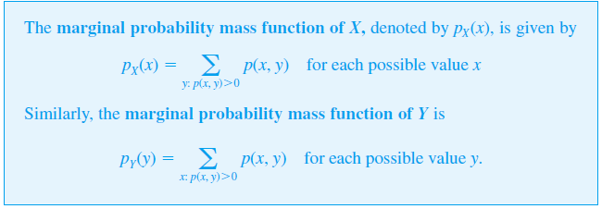
Marginal PMF

Slide 9
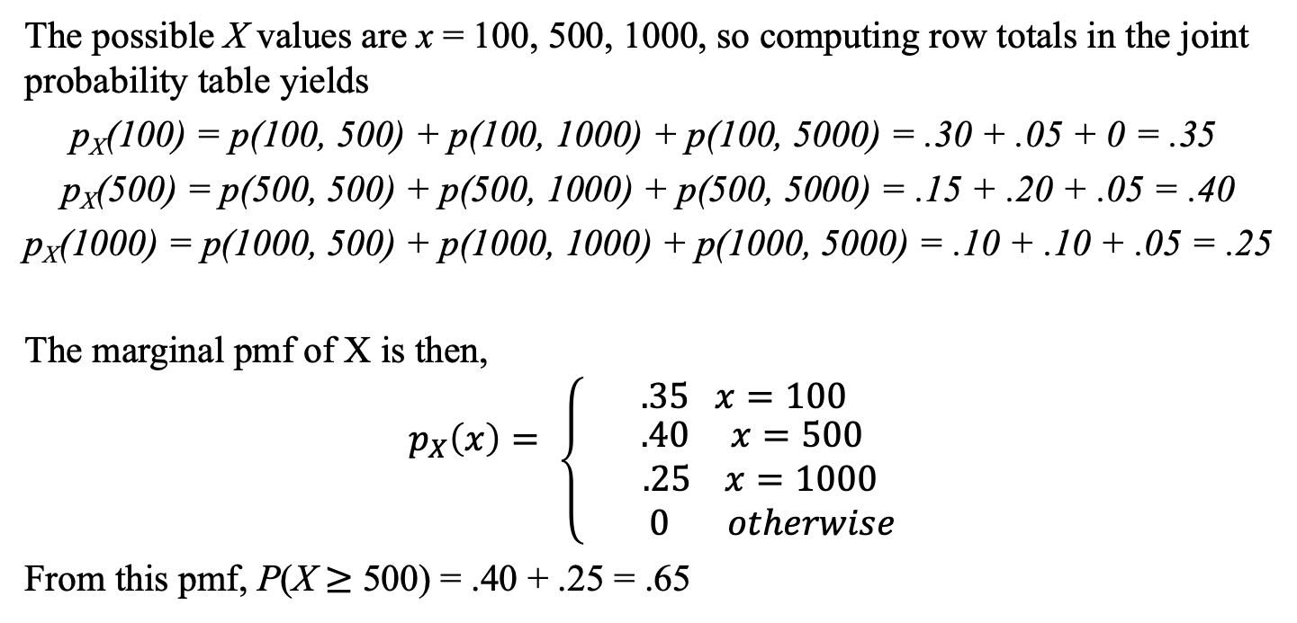
Example 2
cont’d
The possible X values are x = 100, 500, 1000, so computing row totals in the joint probability table yields
p_{X}(100) = p(100, 500) + p(100, 1000) + p(100, 5000) = .30 + .05 + 0 = .35
p_{X}(500) = p(500, 500) + p(500, 1000) + p(500, 5000) = .15 + .20 + .05 = .40
p_{X}(1000) = p(1000, 500) + p(1000, 1000) + p(1000, 5000) = .10 + .10 + .05 = .25
The marginal pmf of X is then,
$$p_{X}\left(x\right)= \left\{ {.35 x=100 \atop \begin{aligned} .40 x=500 \\ .25 x=1000 \\ 0 otherwise\end{aligned}}\right.$$
From this pmf, P(X $≥$ 500) = .40 + .25 = .65

Slide 10
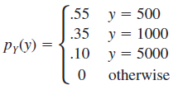
Example 2
cont’d
Similarly, the marginal pmf of Y is obtained from the column totals as

Slide 11
Two Continuous Random Variables

Slide 12
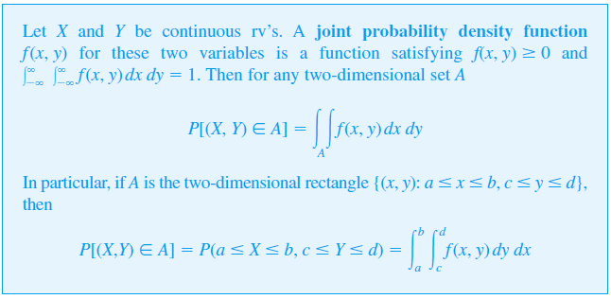
Two Continuous Random Variables
The probability that the observed value of a continuous rv X lies in a one-dimensional set A (such as an interval) is obtained by integrating the pdf f (x) over the set A.
Similarly, the probability that the pair (X, Y) of continuous rv’s falls in a two-dimensional set A (such as a rectangle) is obtained by integrating a function called the joint density function.

Slide 13
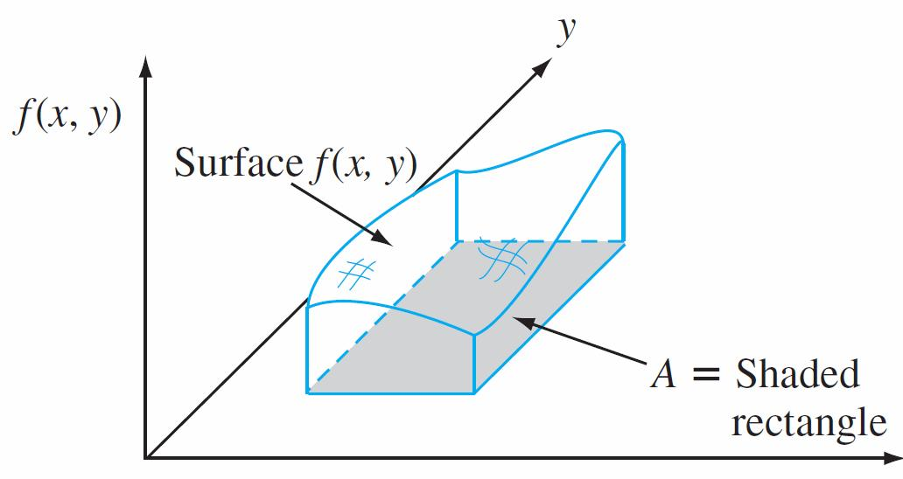

Two Continuous Random Variables
We can think of f (x, y) as specifying a surface at height f(x, y) above the point (x, y) in a three-dimensional coordinate system. Then P[(X, Y) ∈ A] is the volume underneath this surface and above the region A, analogous to the area under a curve in the case of a single rv.
$$x$$
P[(X, Y ) ∈ A] = volume under density surface above A

Slide 14
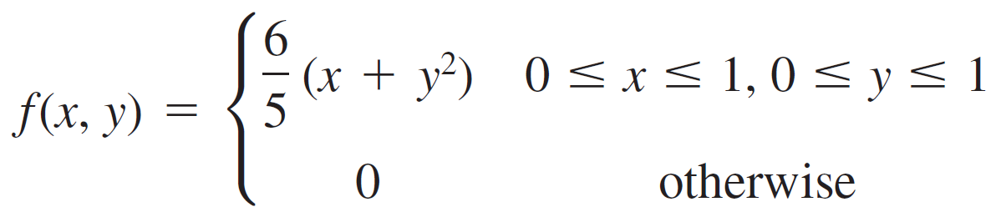
Example 3
A bank operates both a drive-up facility and a walk-up window.
On a randomly selected day,
let X = the proportion of time that the drive-up facility is in use (at least one
customer is being served or waiting to be served) Y = the proportion of time that the walk-up window is in use.
Then the set of possible values for (X, Y) is the rectangle
D = {(x, y): 0 ≤ x ≤ 1, 0 ≤ y ≤ 1}.
Suppose the joint pdf of (X, Y) is given by
Q1) Verify that this is a legitimate pdf.
Q2) Find the probability that neither facility is busy more than one-quarter of the time.

Slide 15
Example 3
cont’d
Q1) To verify that this is a legitimate pdf, note that f (x, y) ≥ 0 and

Slide 16
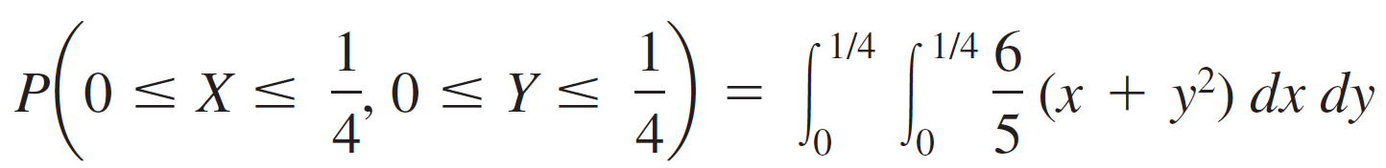
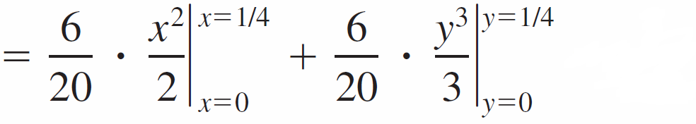
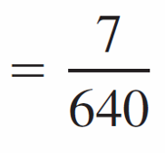

Example 3
cont’d
Q2) The probability that neither facility is busy more than one-quarter
of the time is

Slide 17
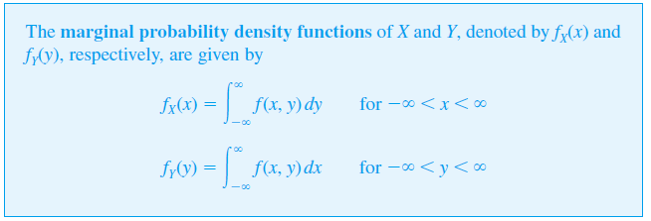
Marginal pdf
The marginal pdf of each variable can be obtained in a manner analogous to what we did in the case of two discrete variables.
The marginal pdf of X at the value x results from holding x fixed in the pair (x, y) and integrating the joint pdf over y. Integrating the joint pdf with respect to x gives the marginal pdf of Y.

Slide 18


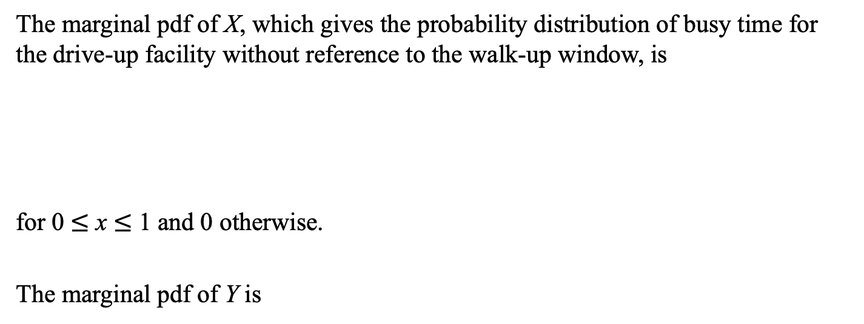
Example 3
cont’d
The marginal pdf of X, which gives the probability distribution of busy time for the drive-up facility without reference to the walk-up window, is
for 0 $≤$ x $≤$ 1 and 0 otherwise.
The marginal pdf of Y is

Slide 19
More Than Two Random Variables

Slide 20
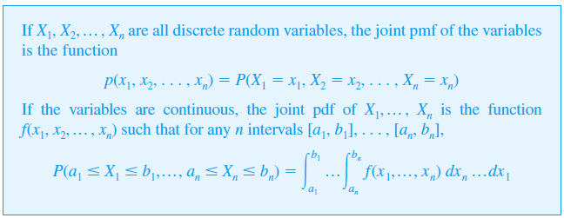
More Than Two Random Variables
To model the joint behavior of more than two random variables, we extend the concept of a joint distribution of two variables.

